Slide 1
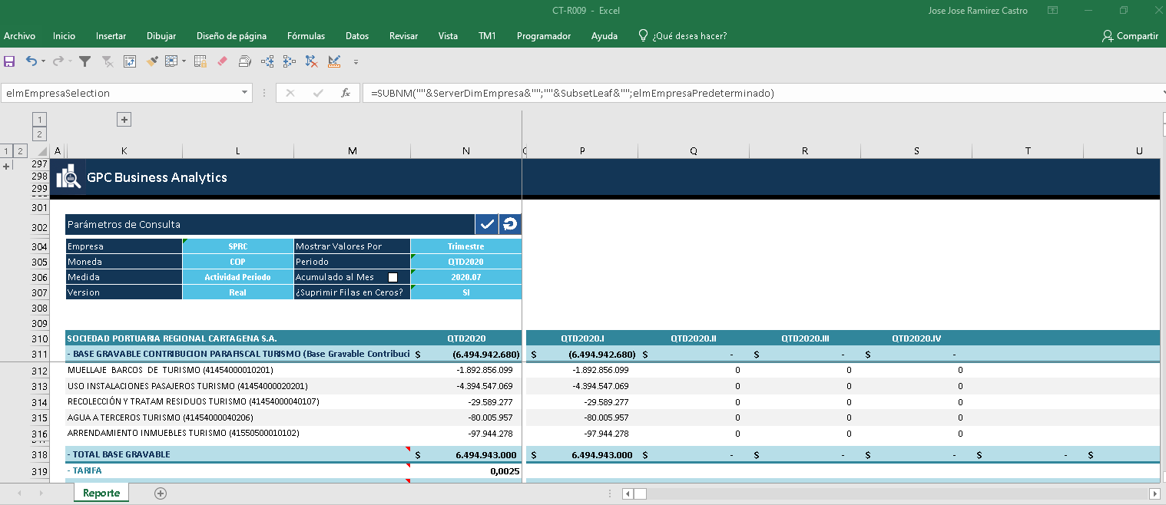
SUBNM´s
TM1RPTROW
DBRW’s
Rows generated by the TM1RPTROW
Active form opened in TM1 Perspectives (TM1 10.2.2). Everything is working as expected.

Slide 2
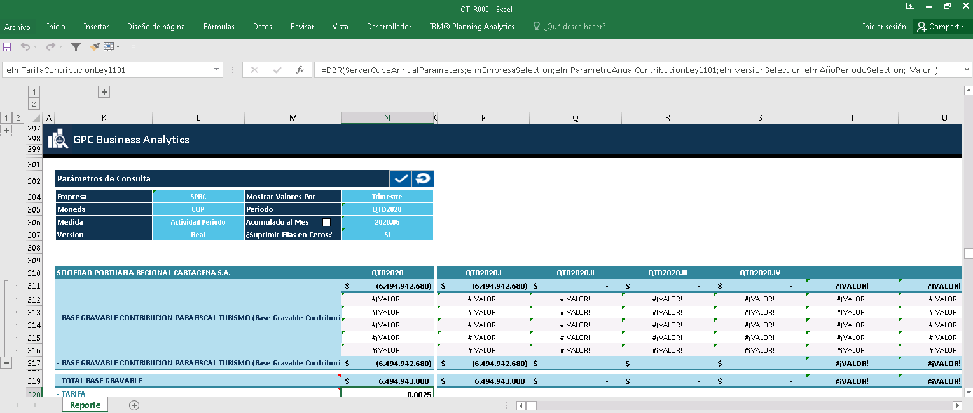
Same Active Form opened in PAX
SUBNM´s
DBRW’s
1
3
2
TM1RPTROW generates the required rows for the active form but then it group that rows(1) and merge(2) the cells. The result is TM1RPTROW only shows the first element and the active form is retreiving data only for that element in the first row, but not for the other rows as DBRW’s (3) are waiting for the dimension element from TM1RPTROW but the cells references are empty as they are all merged.

Slide 3
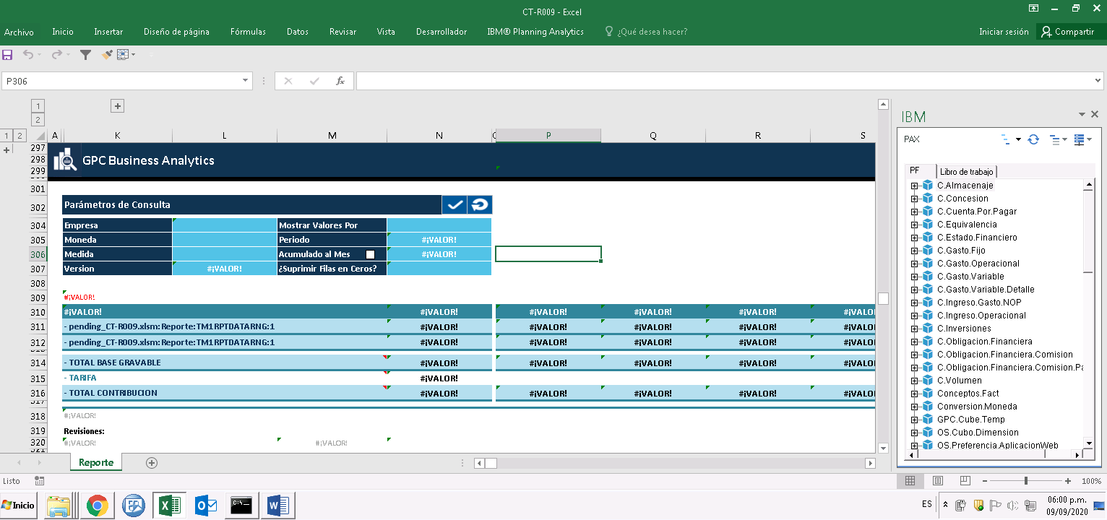
SUBNM´s
TM1 Instance Connected
DBRW’s
TM1RPTROW’s
The Active Form is not retrieving data from TM1 server after login to the required TM1 Instance. Any formula is being updated.

