Slide 1
TM1-version 9.5.2
Some Tips
August 1, 2013

Slide 2
Tip 1
Calculation Mode is controlled in 2 ways:
Excel’s Calculation Mode
TM1’s Rebuild Option

Slide 3
Excel’s Calculation Mode works as follows:
For details see: http://support.microsoft.com/kb/214395
The first document opened uses the calculation mode with which it was last saved. Subsequently opened documents use the same mode.
For example, if you open Auto1.xls and then open Manual1.xls, both documents use automatic calculation (the mode used by Auto1.xls). If you open Manual1.xls and then open Auto1.xls, both documents use manual calculation.
Changing the calculation mode of one open document changes the mode for all open documents.
If Auto1.xls and Auto2.xls are both open, changing the calculation mode of Auto2.xls to manual also changes the mode of Auto1.xls to manual.
All sheets contained in a workbook use the same mode of calculation.
If Auto2.xls contains three worksheets, changing the mode of calculation of the first worksheet to manual also changes the mode of calculation to manual in the other two sheets.
If all other documents are closed and you create a new document, the new document uses the same calculation mode as the previously closed documents.
However, if you use a template, the mode of calculation is the mode that is specified in the template.
If the mode of calculation in a workbook has changed and the file is saved, the current mode of calculation is saved.
If Auto1.xls is opened, Manual1.xls is opened, and Manual1.xls is immediately saved, the mode of calculation is saved as automatic.

Slide 4
TM1 Rebuild Option: slide 1
A new calculation model was introduced in TM1 9.4 which forced an automatic recalculation of all sheets in a workbook, even when the Excel calculation mode was set to Manual. The new model forced a recalculation upon initial opening of any workbook, upon element selection via a SUBMN formula, or upon any server connect event.
TM1 now includes a new workbook name variable, TM1REBUILDOPTION, which lets you manage calculation in workbooks containing TM1 slices and Active Forms. When you create a slice or Active Form in TM1, the TM1REBUILDOPTION name is automatically created in the corresponding Excel workbook and set to 1, indicating that all worksheets in the current workbook should be rebuilt and recalculated when a TM1 server connect event occurs.

Slide 5
TM1 Rebuild Option: slide 2
If TM1REBUILDOPTION is present in a workbook and set to 0, or if TM1REBUILDOPTION is not present in a workbook, worksheets are not rebuilt/recalculated when a server connect event occurs.
Modifying the TM1REBUILDOPTION Setting
If you do not want workbooks created with TM1 9.5 to automatically rebuild and recalculate all slices and Active Forms when a server connect event occurs, you can set the TM1REBUILDOPTION value to 0.
Steps
In Excel, click Insert, Name, Define.
In the Define Name dialog box, select TM1REBUILDOPTION.
Set the value in the Refers to box to =0.
Click OK.

Slide 6
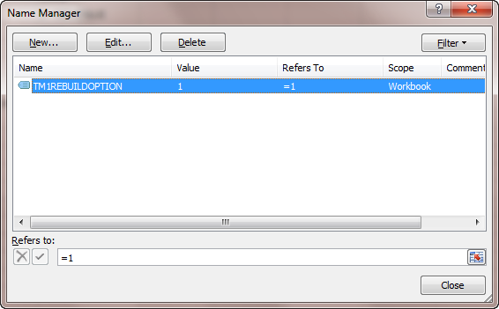
TM1 Rebuild Option : slide 3
Determine if TM1has inserted a name that will trigger an
Auto-calculation. If ‘Refers to’ is set to ‘1’, the workbook will auto-calculate.
Steps
In Excel, click Insert, Name, Define.
In the Define Name dialog box, select TM1REBUILDOPTION.
Set the value in the Refers to box to =0.
Click OK.

Slide 7
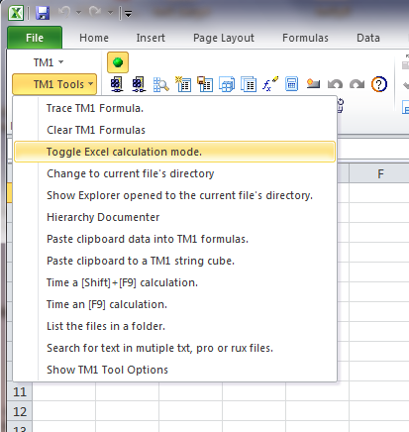
Solution: Auto-calculation
Before opening any financial model, ensure that Excel’s calculation mode is set to Manual.
You can use the ‘TM1 Tools’ add-in to do this. Select ‘Toggle Excel Calculation Mode’, from the ‘TM1 Tools’ Add-in.
If your financial model auto calculates with the Excel calculation mode set to manual, you need to look for the TM1 workbook name variable, TM1REBUILDOPTION.

Slide 8
Tip 2
TM1 slices crash or hang Excel

Slide 9
Solution: TM1 Slice to Excel Hangs
When slicing a cube view to Excel from TM1 Server Explorer, TM1 Perspectives opens and hangs, never returning the sliced cube view.
Resolving the problem
Microsoft Excel 2010
1. Click the File tab, and then click Options.
2. Click Advanced, and then click to clear the Ignore other applications that use Dynamic Data Exchange (DDE) check box in the General area.
3. Click OK.
Microsoft Office Excel 2007
1. Click the Microsoft Office Button, and then click Excel Options.
2. Click Advanced, and then click to clear the Ignore other applications that use Dynamic Data Exchange (DDE) check box in the General area.
3. Click OK.
Microsoft Office Excel 2003 or earlier versions of Excel
1. Click Options, on the Tools menu.
2. Click the General tab.
3. Click to clear the Ignore other applications that use Dynamic Data Exchange (DDE) check box, and then click OK.

Slide 10
Tip 3
TM1 Performance on Wide Area Network
What is a Wide Area Network ?
Use TM1 functions for WAN
Use the Citrix Portal

Slide 11
TM1 Server is on a WAN
LAN
Stands for "Local Area Network," A LAN is a computer network limited to a small area such as an office building, university, or even a residential home. Most mid to large-sized businesses today use LANs, which makes it easy for employees to share information.
WAN
Stands for "Wide Area Network." It is similar to a Local Area Network (LAN), but it's a lot bigger. Unlike LANs, WANs are not limited to a single location. Many wide area networks span long distances via telephone lines, fiber-optic cables, or satellite links. They can also be composed of smaller LANs that are interconnected. The Internet could be described as the biggest WAN in the world.

Slide 12
TM1 Server is on a WAN
WAN performance is known to suffer with TM1, especially when compared to LAN performance. TM1 is a very 'chatty' application and as such the latencies and extra overhead associated with WAN connections cause the user experience to suffer.

Slide 13
TM1 Functions for WANs
Make sure to use WAN-optimized functions in the sheets. For example, use DBRW,
instead of DBR. Keep in mind that a DBRW function should not reference another
DBRW cell, so there are situations where you will need to keep a DBR in a sheet, but the
bulk of them can be changed to DBRWs for better performance

Slide 14
VIEW Function
VIEW
A single VIEW function is created when you slice a view from a cube browse.
This function creates an optimized view of the cube specified by the cube argument. All DBR and DBRW formulas that refer to the VIEW function can then access this optimized view. In this way, results are returned much faster.
Multiple VIEW functions can reside in the same spreadsheet if you have blocks of DBR formulas that refer to different TM1 views and/or cubes.
Syntax
VIEW(cube, e1,e2[,...en])

Slide 15
DBRW Function
DBRW
This function retrieves a value from a specified TM1 cube. When all element arguments (e1, e2, etc.) to the function are leaf elements, the DBRW function can also be used to write values to the specified cube, provided that the user has appropriate access privileges to the relevant cube, dimensions, elements, and/or cells.
This function works the same as the DBR function, with one major difference; DBRW reduces network traffic and may improve performance on wide area networks.
In worksheets with a large number of TM1 functions, DBRW forces TM1 to execute functions in "bundles" rather than individually. Normal DBR functions are executed individually during a worksheet recalculation. DBRW functions force TM1 to execute two passes over the worksheet. In the first pass, all changed values in cells containing DBRW functions are sent in a single bundle to the cube. In the second pass, cube values are sent in a single bundle back to the worksheet. Consequently, the worksheet recalculates twice when DBRW functions are executed.
DBRW bundling occurs when the function is used in a standalone cell. When DBRW functions are used in complex calculations, the function operates as a DBR function so no performance gains accrue.
Syntax
DBRW(cube, e1, e2[,...en])

Slide 16
DBRW Function
DBRW
This function retrieves a value from a specified TM1 cube. When all element arguments (e1, e2, etc.) to the function are leaf elements, the DBRW function can also be used to write values to the specified cube, provided that the user has appropriate access privileges to the relevant cube, dimensions, elements, and/or cells.

Slide 17
SUMNM Function (Optional)
SUBNM
This function returns the element of a dimension subset corresponding to the IndexOrName argument. When you double-click a cell containing a SUBNM function, the Subset Editor opens. You can then select a new element to place in your worksheet. The selected element becomes the return value of the SUBNM function, and the function automatically updates the IndexOrName argument to reflect the new element.
If you include the optional Alias parameter to this function, the function returns the alias for the selected element
Note: Do not use cell references as arguments with the SUBNM function. Cell references prevent the function from correctly calling and launching the Subset Editor when you double-click the cell that contains the SUBNM function.
Syntax
SUBNM(Dimension, Subset, IndexOrName, [Alias])

Slide 18
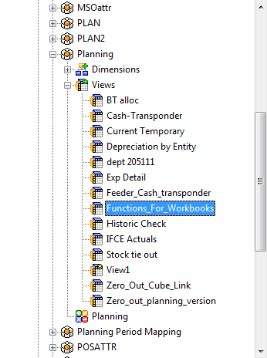
TM1 Functions – Quick Start
A view was set up in TM1’s Planning cube.
Slice the view to Excel.
You can copy and paste one or more of the functions to your financial model.
Double-click on the view named ‘Functions_for_Workbooks’
Slice the View to Excel.

Slide 19
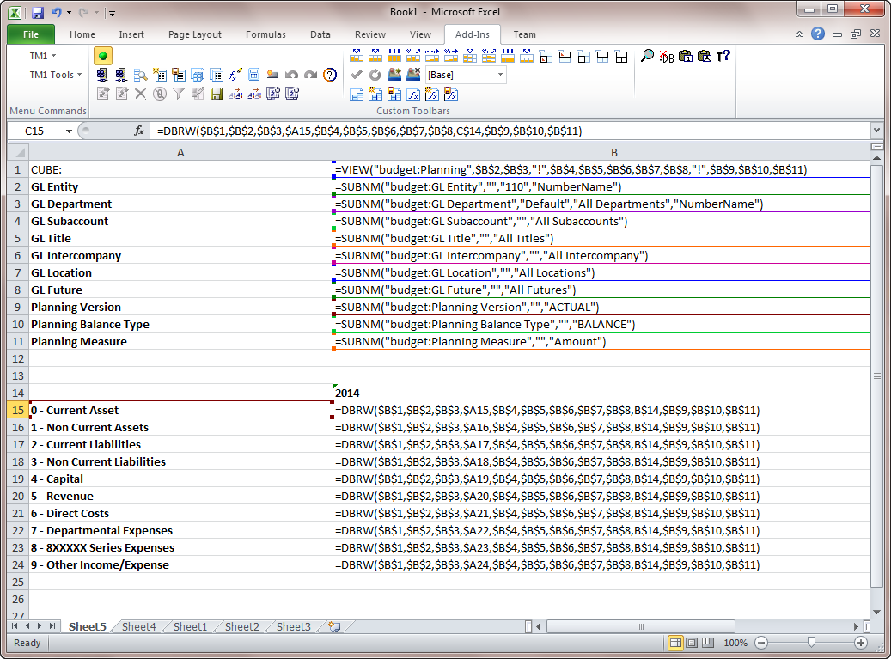
To See Functions – (Ctrl + `)
The key combination that can be used to show formulas is:
Ctrl + `
Press and hold down the Ctrl key on the keyboard
Press and release the
grave accent key ( ` ) key on the keyboard without releasing the Ctrl key
Release the Ctrl key
The grave accent key is located next to the number 1 key on the top left corner of the keyboard and looks like a backwards apostrophe.

Slide 20
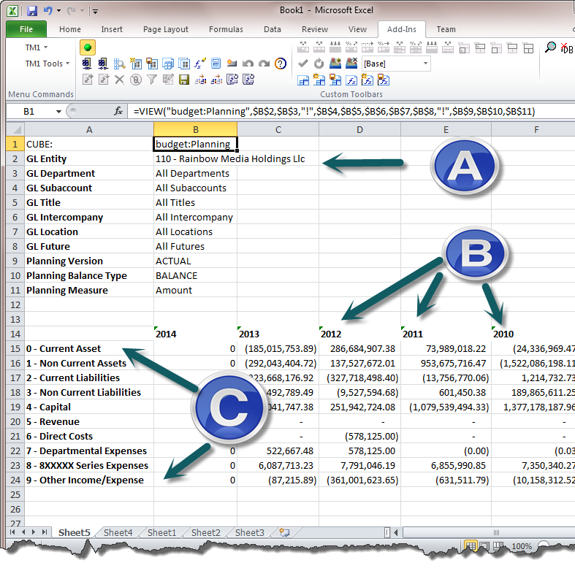
VIEW Function - WAN
  Utilize the View function in your sheets as this will make the sending/retrieval of data faster. If you don't use at least one View function then your DBRW formula may be behaving more like DBRs - each traveling in separate packets.
  VIEW Function:
  =VIEW("budget:Planning",$B$2,$B$3,"!",$B$4,$B$5,$B$6,$B$7,$B$8,"!",$B$9,$B$10,$B$11)
  Note how ‘!” is used for row or column values.
  Specific cell references are used for Header references
  You must modify your VIEW functions so that Row and Column function arguments use “!” and Header function arguments use the specific cell references.
Headers
Columns
Rows

Slide 21
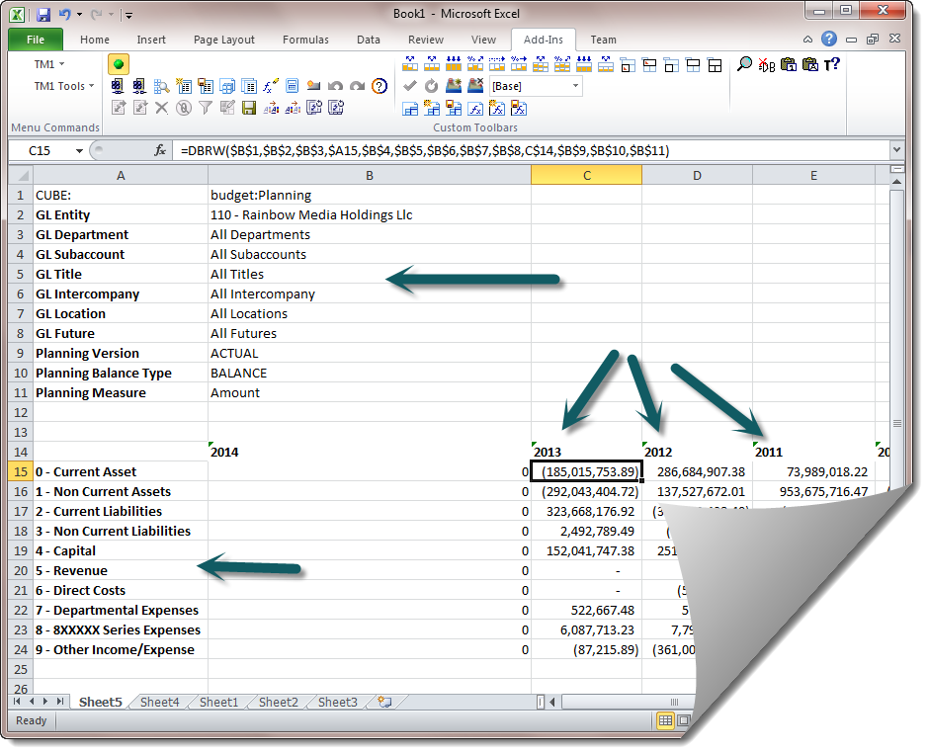
DBRW Function - WAN
  In your financial models, you should use TM1 functions in the same way that a slice from a cube viewer is created.
  DBRW Formula:
  =DBRW($B$1,$B$2,$B$3,$A15,$B$4,$B$5,$B$6,$B$7,$B$8,C$14,$B$9,$B$10,$B$11)
Headers
Columns
Rows

Slide 22
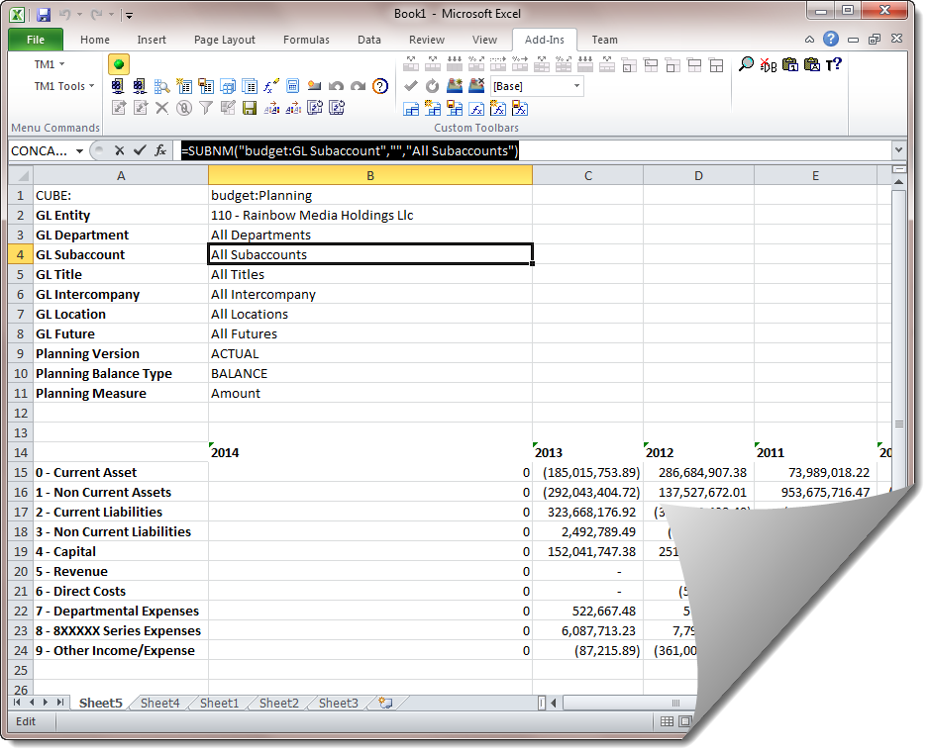
SUBNM Formula
  You do not have to use the SUBNM functions. They are nice, since you can double click on them and select a value.
  If you use them, use them for Header values.
  SUBNM Formula:
  =SUBNM("budget:GL Subaccount","","All Subaccounts")
Headers
Columns
Rows

Slide 23
TM1 Formula - References
You might find it useful to print out the following 2 slides as a reference:
DBRW – Planning Cube Template.
Provides a visual reminder of the positions of the DBRW function’s arguments in the Planning cube (entity, dept…).
Can be used when developing/modifying your financial model to record the cell references ($B$2) of functions arguments.
VIEW – Planning Cube Template.
Provides a visual reminder of the positions of the VIEW function’s arguments in the Planning cube (entity, dept…).
Can be used when developing/modifying your financial model to record the cell references ($B$2) of functions arguments.

Slide 24
DBRW – Planning Cube Template
(3) (6) (6) (5) (4) (3) (7) (4)
Cube
Entity
Dept.
Account
Sub
Acct
Title
IC
Location
Future
Period
Version
Bal.
Type
Measure
K1 K2 K3 K4 K5 K6 K7 K8 K9 K10 K11 K12
R
C
H
R
C
H
R
C
H
R
C
H
R
C
H
R
C
H
R
C
H
R
C
H
R
C
H
R
C
H
R
C
H
R
C
H
R
C
H
R = Row; C = Column, H= Header.
The ‘K’ are the parameter references found when pressing Excel’s button

Slide 25
VIEW– Planning Cube Template
(3) (6) (6) (5) (4) (3) (7) (4)
Cube
Entity
Dept.
Account
Sub
Acct
Title
IC
Location
Future
Period
Version
Bal.
Type
Measure
D1 D2 D3 D4 D5 D6 D7 D8 D9 D10 D11 D12
R
C
H
R
C
H
R
C
H
R
C
H
R
C
H
R
C
H
R
C
H
R
C
H
R
C
H
R
C
H
R
C
H
R
C
H
R
C
H
R = Row; C = Column, H= Header. In the VIEW function, use “!” for Column and Row Function Arguments
The ‘D’s’ are the Function Arguments references found when pressing Excel’s button

Slide 26
TM1 DBRW Function Explained
  DBRW is the abbreviation for Data Base Reference Wide area network.
  The DBRW formula is optimized regarding network traffic and server side calculation. TM1 also provides formula that are not optimized. The formula that corresponds to DBRW is the DBR formula. Consider what will happen if we use the DBR formula instead of DBRW. When MS Excel calculates a sheet, it will calculate cell by cell. If a formula refers to another cell, the referenced cell has to be calculated first. So each DBR formula is calculated separately, which means that all values are retrieved from the TM1 server cell by cell and not in a whole bunch.
  This might result in heavy network traffic and in slow response times.
  The DBRW formula works in a different way. If you calculate an Excel sheet containing this formula, the TM1 Add-In will collect the DBRW requests and retrieve the requested values in one or more chunks. To make this work, the TM1 add-in will take over the calculation mechanism of Excel. TM1 changes the calculation mechanism into a three-step process.

Slide 27
TM1’s DBRW formula 3-Step Process
  Step 1
  In the first step all necessary Excel cells have to be calculated. The DBRW formula can refer to other Excel cells with formulas. The DBRW formula needs the values of these cells as coordinates for a TM1 cube cell.
  Step 2
  Now the TM1 Add-In can evaluate which DBRW formula can be grouped. All DBRW formula are bundled if they have the same Excel cell reference in the first parameter and the referenced cell contains a VIEW formula. The first parameter is the server/cube name.
  Example: =VIEW("budget:Planning",$B$2,$B$3,$B$4,$B$5,$B$6,$B$7,$B$8,$B$9,$B$10,$B$11,$B$12,$B$13)
  Step 3
  In the third step, the Excel sheet has to be calculated again. The result value of the DBRW formulas does not exist during the first calculation. But some other formulas or Excel charts can refer to cells with DBRW formulas. They need a value during the calculation phase. This is the reason why the TM1 Add-In forces the second calculation.

Slide 28
TM1’s DBSW formula
I don’t recommend using the DBSW formula. It cannot be used when a DBRW formula must be calculated first. In many of the models
a value is retrieved from the cube and then changed in some way within the financial model and then sent back to a different category (CURRENT, for example).
The same process is followed by TM1’s DBSW formula.
DBSW This is a TM1 worksheet function, valid only in worksheets.
DBSW sends a numeric value to a TM1 cube. This function cannot send a string to a cube. To send strings, use the DBSS function.
This function works the same as the DBS function, with one major difference; DBSW reduces network traffic and may improve performance on wide area networks.
In worksheets with a large number of cube references, DBSW forces TM1 to send values in bundles rather than individually. Normal DBS functions are updated individually during a recalculation. DBSW references force TM1 to send all changed values within a worksheet in a single bundle.
In such circumstances you can safely use a DBS/DBR function as an argument to a DBS function.
Note: DBSW/VBA interaction: If you use VBA to calculate a worksheet containing DBSW functions, you must call the TM1 macro function to calculate the worksheet. Do not use the VB Calculate method to calculate a worksheet containing DBSW functions; doing so causes each DBSW function to be executed individually, defeating the purpose of the function and resulting in decreased performance.Syntax
DBSW(value, cube, e1, e2[,...en])Arguments

Slide 29
‘W formula and Dependencies
  You cannot use a DBRW that depends on another DBRW formula.
  You cannot use a DBSW formula that depends on a DBRW formula.

Slide 30
‘W formula and Dependencies
  You cannot use a DBRW that depends on another DBRW formula.
  You cannot use a DBSW formula that depends on a DBRW formula.
  The function of DBRW formulas as opposed to DBR formulas is that they are more optimized for reducing network traffic and the number of packets sent back and forth between client and server. In Excel manual calculation mode Perspectives gathers up all DBRW references on the calculation event and submits a single request and similarly gets all values back from the server in one message. In the meantime while the client is waiting to hear back from the server with updated values the cells are populated with a temporary value of "RECALC". For this reason you can't have a DBRW linking to another DBRW to obtain a dimension element reference as the address will be invalid during the recalculation event. The same of course goes for DBSW linking to DBRW.
  If you substitute in either a DBR or DBS then these formulas follow the standard Excel "one cell at a time" recalculation model and resolve their dependencies which avoids the error. Which in your case could be either from trying to send a value of "RECALC" to a numeric leaf cell or from having one or more internal element address references having a value of "RECALC".
  DBR and DBS are by nature less efficient so you don't want to have too many of them in a sheet that is used over a network.

Slide 31


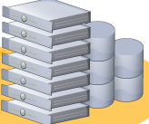

Use Citrix to Move Client Processing Closer to TM1 Server
11 Penn Plaza
Data Center - NJ
12.3, 4.56…
WAN
DBRW…
Press F9
F9
TM1 Server
When using Citrix, only the data you enter via your keyboard travels to NJ, and a compressed “television like” image of your Excel session is returned to you local desktop via Citrix Portal.
When using a local desktop install of TM1, all of the DBRW formula travel from 11 Penn to NJ, and all of the data requested travel back to your desktop PC.
Citrix Servers
TM1 client and Excel run on Citrix servers

Slide 32
Financial Models –
Financial Models – Some Financial Models - Maintenance
Delete named ranges if not used.
Delete invalid Excel Links.
Upgrade to Excel 2010
Save old .xls Workbooks as .xslx Workbooks
Large Excel workbooks – Broken into Subject AreaWorkbooks

Slide 33
Delete Unused Named Ranges
Delete Unused Named Ranges
Determine if named ranges are used. A lot of named ranges seem to have been unintentionally copied to workbooks. It seems that when you copy data from one workbook to another, you also copy the named ranges.
How?
1. Make backup copy of your Excel model.
2. Determine if the named ranges are used.
3. Use Excel’s name manger to delete invalid and unused named ranges.
4. Test your model. If it does not work, revert to the backup.

Slide 34
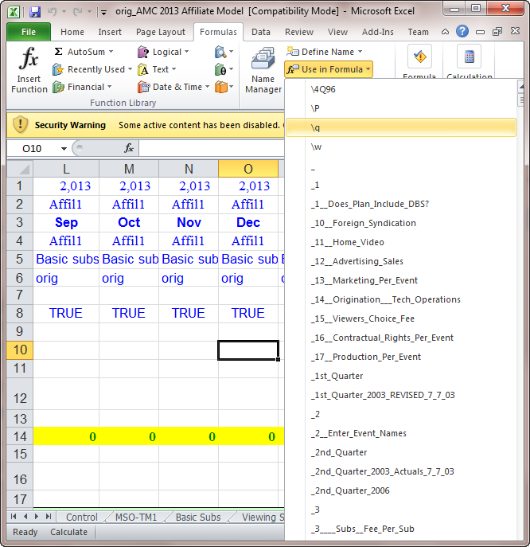
Select Formula Drop Down Menu
List named ranges with Use in Formula drop down menu
Apart from Name Manager, you can also view all defined named with Use in Formula command under Formula tab.
Just clicking the Use in Formula button, it lists all named ranges. See screenshot
:

Slide 35
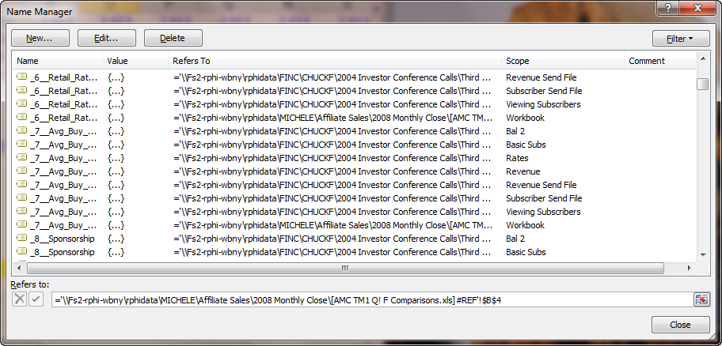
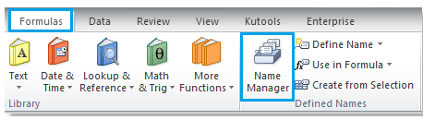
Select Formula – Name Manager
Usually we can edit defined names with Name Manager command.
We can view all defined names within the Named Manager dialog box.
After clicking the Name Manger button under Formulas tab, it displays the Name Manger dialog box. And it lists all named ranges within it. See screenshot:

Slide 36
Delete Unused Excel Links
Excel Links
Many of the Excel links exist because the workbook has named ranges that refer to another workbook.
So deleting the unused named ranges also deletes the Excel link.

Slide 37
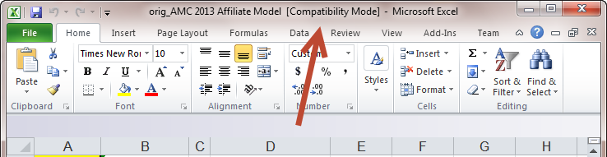
Upgrade to Excel 2010
Excel 2003
Excel 2003 files are open in compatibility mode by Excel 2010

Slide 38
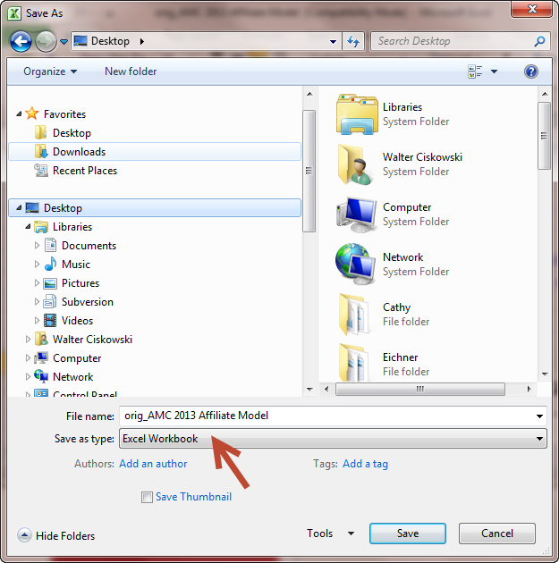
Upgrade to Excel 2010’s .xlsx file type
Excel 2003
.xls extension
Excel 2010
.xlsx extension
Excel 2003 files are open in compatibility mode by Excel 2010

Slide 39
Large Excel Workbooks
Subject Areas:
-P&L
-Balance Sheet
-Cash flow
Delete any worksheets that are not being used.
If you have large workbooks with many sheets, see if they can be broken into workbooks with fewer sheets.

