Slide 1
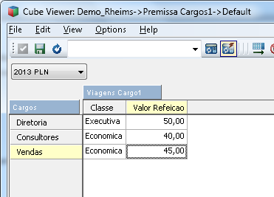
First Cube A – Have Assumptions Information about field Cargo

Slide 2
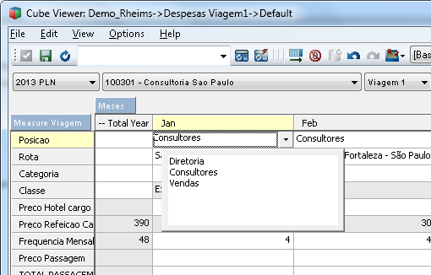
Second Cube B – When I select the field Posicao and choose a Cargo (the same dimension in cube A).

Slide 3
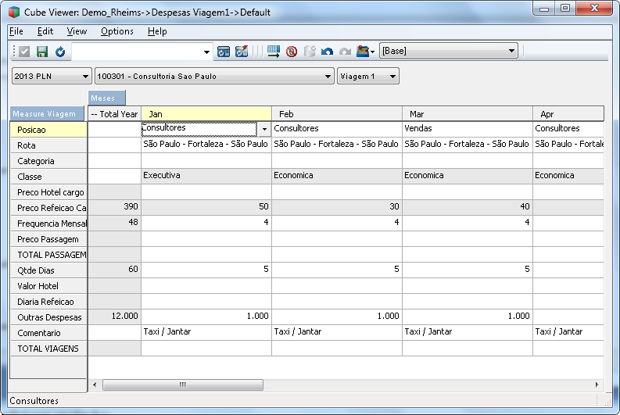
I want the class field changes as the registration of the cube

Slide 4
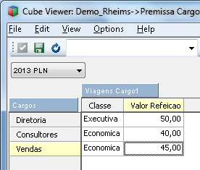
Look the two cubes, I want when I choose the field Posicao , the CLASSE field come as automatic registration on The Cube B

